Slide 1

Web fundamentals
HTML and CSS

Slide 2
Chapter 1 HTML and CSS revision

Slide 3
Objectives
In this chapter, you will:
Revise the HTML and CSS that you covered in the pre-learning.

Slide 4
HTML Tags
HTML consists of text, combined with tags like <this>.
Write down as many tags as you can remember.
Look at the tags you’ve written down:
Do any of them need to come in a specific order, or in specific places?
Do any of them need to be closed? How would you do that?
General page layout :
Within this general layout:
Many tags need to be closed – repeat the tag with a /.
Some tags can’t be placed within other tags.
E.g., it doesn’t make sense to put a <p> within a <span>.
<!DOCTYPE html>
<html>
<head><title>Title</title></head>
<body>Body of page goes here</body>
</html>

Slide 5
HTML5 page (Hypertext Markup Language)
Information to the browser to ensure web page is parsed the same way by different web browsers
<!DOCTYPE html>
<html lang="en">
<head>
<meta charset="UTF-8">
<meta name="viewport" content="width=device-width, initial-scale=1.0">
<title>Document</title>
</head>
<body>
</body>
</html>
<script src="qaScript.js"></script>
<link href="qaStyle.css" rel="stylesheet" />
Best display for the user’s viewport
Best in a separate files
In older documents (like HTML 4 or XHTML), the DOCTYPE refers to a DTD (Document Type Definition).
HTML 4.01: <!DOCTYPE HTML PUBLIC "-//W3C//DTD HTML 4.01 Transitional//EN" "http://www.w3.org/TR/html4/loose.dtd">
XHTML 1.1: <!DOCTYPE html PUBLIC "-//W3C//DTD XHTML 1.1//EN" "http://www.w3.org/TR/xhtml11/DTD/xhtml11.dtd">

Slide 6
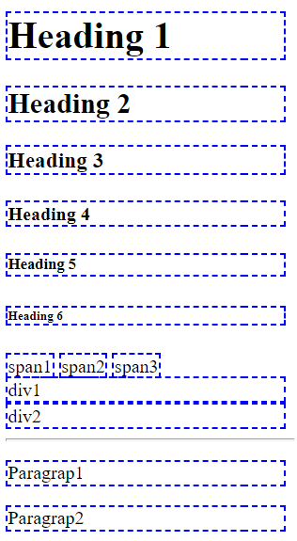
Revision: Tags for displaying data
Displaying text and
<span>
<h1,2,3,4,5,6>
Container
<div>
<p>
Breaks and lines
<hr />
<br />
<h1>Heading 1</h1>
<h2>Heading 2</h2>
<h3>Heading 3</h3>
<h4>Heading 4</h4>
<h5>Heading 5</h5>
<h6>Heading 6</h6>
<span>span1</span>
<span>span2</span>
<span>span3</span>
<br />
<div>div1</div>
<div>div2</div>
<hr />
<p>Paragrap1</p>
<p>Paragrap2</p>

Slide 7
Controls for inputting and selecting data
<input type="___" />
Other attributes
min, max
autocomplete off/on
spellcheck true/false
maxlength
placeholder
disabled
text number email URL password date datetime time day month week submit reset File range
<input type="number" min="1 max="50" placeholder="type a number (1-50)" />
<input type="text" maxlength="10" placeholder="type password (1-10)" required/>
<input type="text" placeholder="type your name" spellcheck="false" autocomplete="off"/>
<button disabled>OK</button>

Slide 8
CSS consists of selectors:
The selector chooses the elements.
You can then change attributes.
Selectors are based on:
The name of the tag.
The id of the tag.
The css class of the tag.
Write a few of these selectors.
How many ways do you know of to join items together within a selector?
CSS selectors

Slide 9
CSS selectors – A few examples
<h1>QA</h1>
<p>Paragraph text</p>
<div>some text in a div</div>
<div id="div1">div with id=div1</div>
<div class="note">div with class=note</div>
<div>
<span>span contained in a div</span>
</div>
<br />
<span>span NOT contained in a div</span>
h1 { text-align: center; }
p {
background-color: lightblue;
border: 1px dashed blue;
padding: 10px;
}
#div1 { color: red; }
.note { background-color: gray; }
div { border:1px solid red; }
span {
background-color: lightyellow;
margin-left: 20px;
}

Slide 10
CSS selectors – A few examples
p, div {
border: 1px dashed black;
box-shadow: 2px 2px 2px gray;
padding: 10px;
}
div span {
background-color: lightgreen;
}
body * {
width: 20%;
}
div:hover {
background-color: yellow;
}
<h1>QA</h1>
<p>Paragraph text</p>
<div>some text in a div</div>
<div id="div1">div with id=div1</div>
<div class="note">div with class=note</div>
<div>
<span>span contained in a div</span>
</div>
<br />
<span>span NOT contained in a div</span>

Slide 11
In this chapter, you:
Revised the HTML you learned on the pre-learning.
Revised the CSS you learned on the pre-learning.
Summary

Slide 12
Lab
During your pre-learning, you may have used the Cloud Academy HTML/CSS editor.
This has some restrictions:
It only allows you to work on one page,
This page can only be shown as part of the editor.
In this lab, you will:
Learn that HTML files are simply plain text.
Learn that using an IDE can simplify the task of writing HTML.
Move your pre-learning into Visual Studio Code, which is an IDE that supports many languages including HTML / CSS.
Chapter 1 - HTML and CSS Revision.docx

